Slide 1
Open Data for Municipal Private infrastructure Investment
Exploration of the World Bank Private Participation in Infrastructure Database

Slide 2
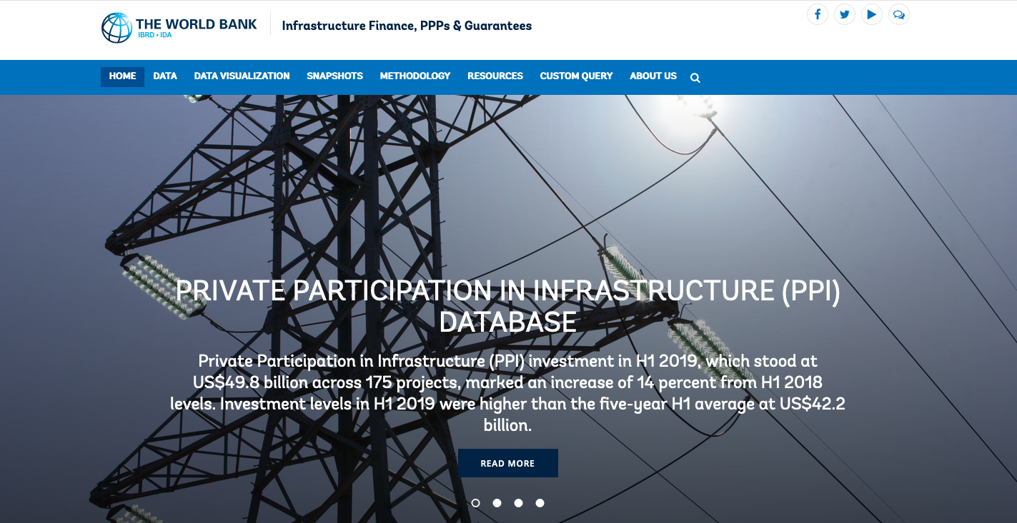
The Data
CCFLA (Cities Climate Finance Leadership Alliance)

Slide 3
The Data
CCFLA (Cities Climate Finance Leadership Alliance)
Government Type | Total Projects | Private Investment (Millions USD) | Year Range
National | 4,611 | 127,136 | 1930 – 2019
State/Provincial | 1,127 | 208,814 | 1985 – 2019
Local/Municipal | 1,837 | 127,139 | 1992 – 2019
Database includes location, sector, investment amounts, contract structure, sponsors, & banks for low and middle income countries

Slide 4
Key Finding
Privately financed municipal infrastructure is different than either national or provincial government projects:
Different sectors
Different technology
Different contract types

Slide 5
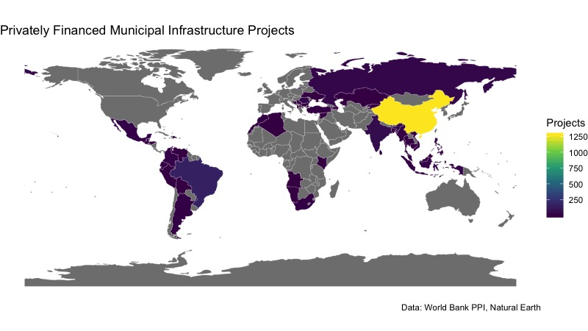
Initial Findings
China accounts for a majority of the municipal projects.

Slide 6
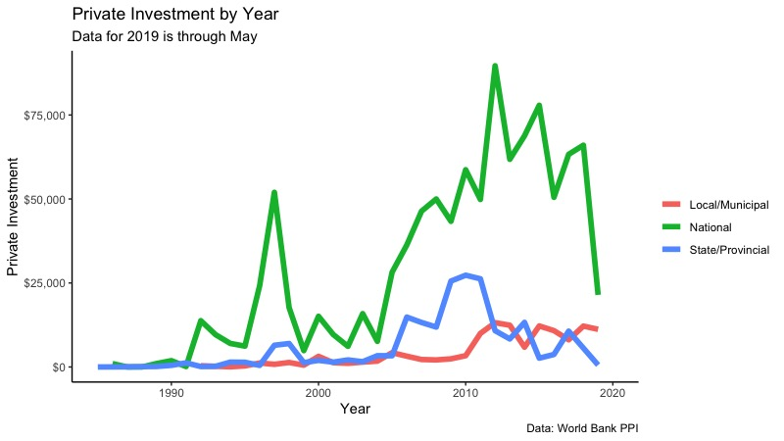
Initial Findings
Private investment in local government projects has outpaced provincial governments but is well behind national governments.

Slide 7
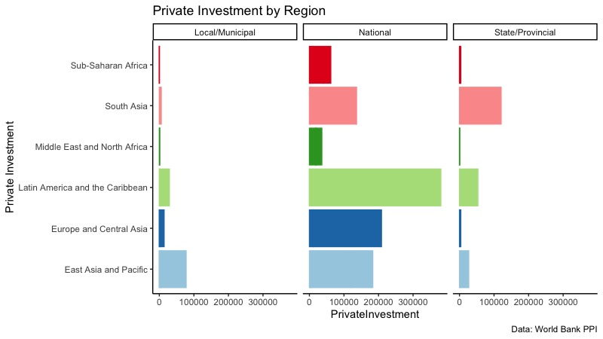
Initial Findings
Private investment varies significantly by region and government type.

Slide 8
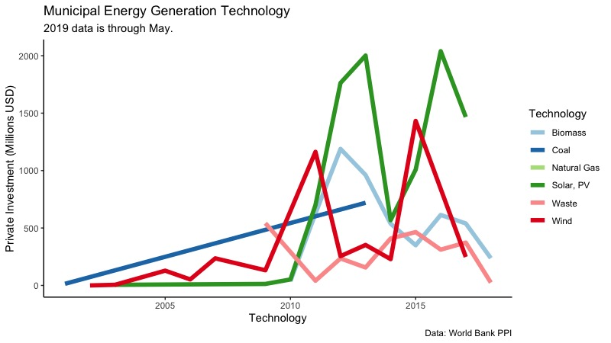
Initial Findings
Energy generation investment at the municipal level has largely made the transition to renewable energy, but there is high variation between years.

